Slide 1
RW5jb2Rpbmc= & Rapelcgvba

Slide 2
Agenda
Encoding
Encryption
Quantum Computing
Historical Examples
PKI
SSL

Slide 3
Encoding
This is NOT a method for securing data!
Encoding is the process of converting data from one format into another.
This is often done to make data easier to read, transmit, or store.
Can be thought of akin to a translation between languages

Slide 4
Encryption
The process of obfuscating easily readable data (plaintext) to be unreadable (ciphertext).
This is accomplished through the use of some Mathematical function often involving prime numbers because it is computationally expensive to factor the product of two, large prime numbers
The ciphertext can be converted back to plaintext if the “key” is known. In the case of RSA encryption this is the primes.

Slide 5
Remember Hashes?
Hashes are NOT a form of encryption as they are intended as a one way process.
Once the plaintext is passed through a hashing algorithm the intent is it cannot be reversed. As we will see in Red Team there are methods for breaking weak hashes.

Slide 6
Encoding Vs. Encryption
Encoding is converting a set of data into another format. Like translating English text into French. The aim is NOT to secure data, but to make data easier to understand, transmit, and/or store.
Encryption is securing plaintext data into an unreadable ciphertext via the use of a mathematical algorithm. This process CAN be reversed with the correct key.

Slide 7



Symmetric Encryption
Uses the same key to encrypt data and decrypt data.
Commonly used to secure data “at rest” like files on your hard drive or databases.
What is the weak point in this scheme?

Slide 8
Symmetric Encryption
Whoever wishes to read the plaintext data must have the key that was used to create the ciphertext.
This means both the sender and receiver need a copy of the key.
The issue becomes if I wish to transmit data over a public network (The Internet) I would need a method of delivering the key to the intended recipient.

Slide 9

Asymmetric Encryption
Uses 2 keys to enable secure communication
The “public key” can be transmitted over an insecure/public connection; it is NOT secret.
The “private key” must be kept secret and is used to decrypt the ciphertext.

Slide 10
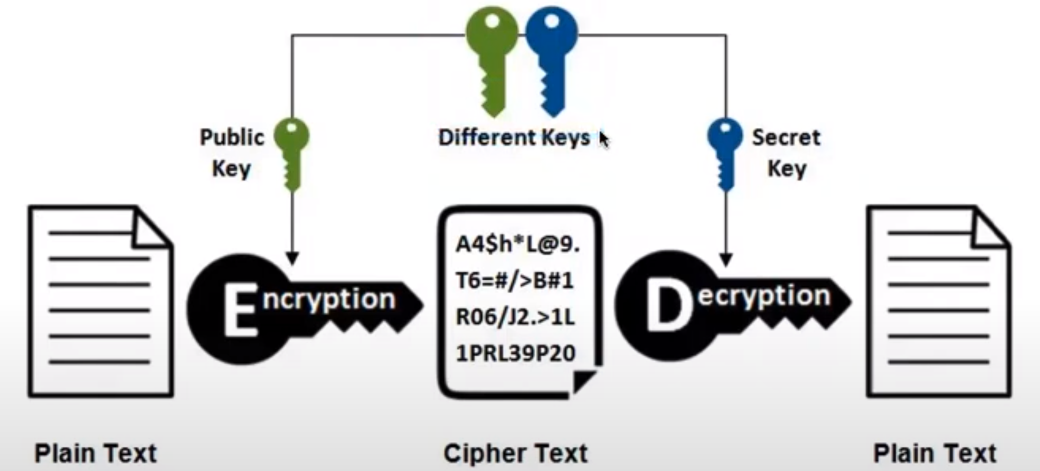
Asymmetric Encryption

Slide 11

Asymmetric Encryption
Asymmetric Encryption is great for sendign and receiving secure data!
Who can see the glaring issue with this scheme?
https://www.nist.gov/image/cia-triad

Slide 12
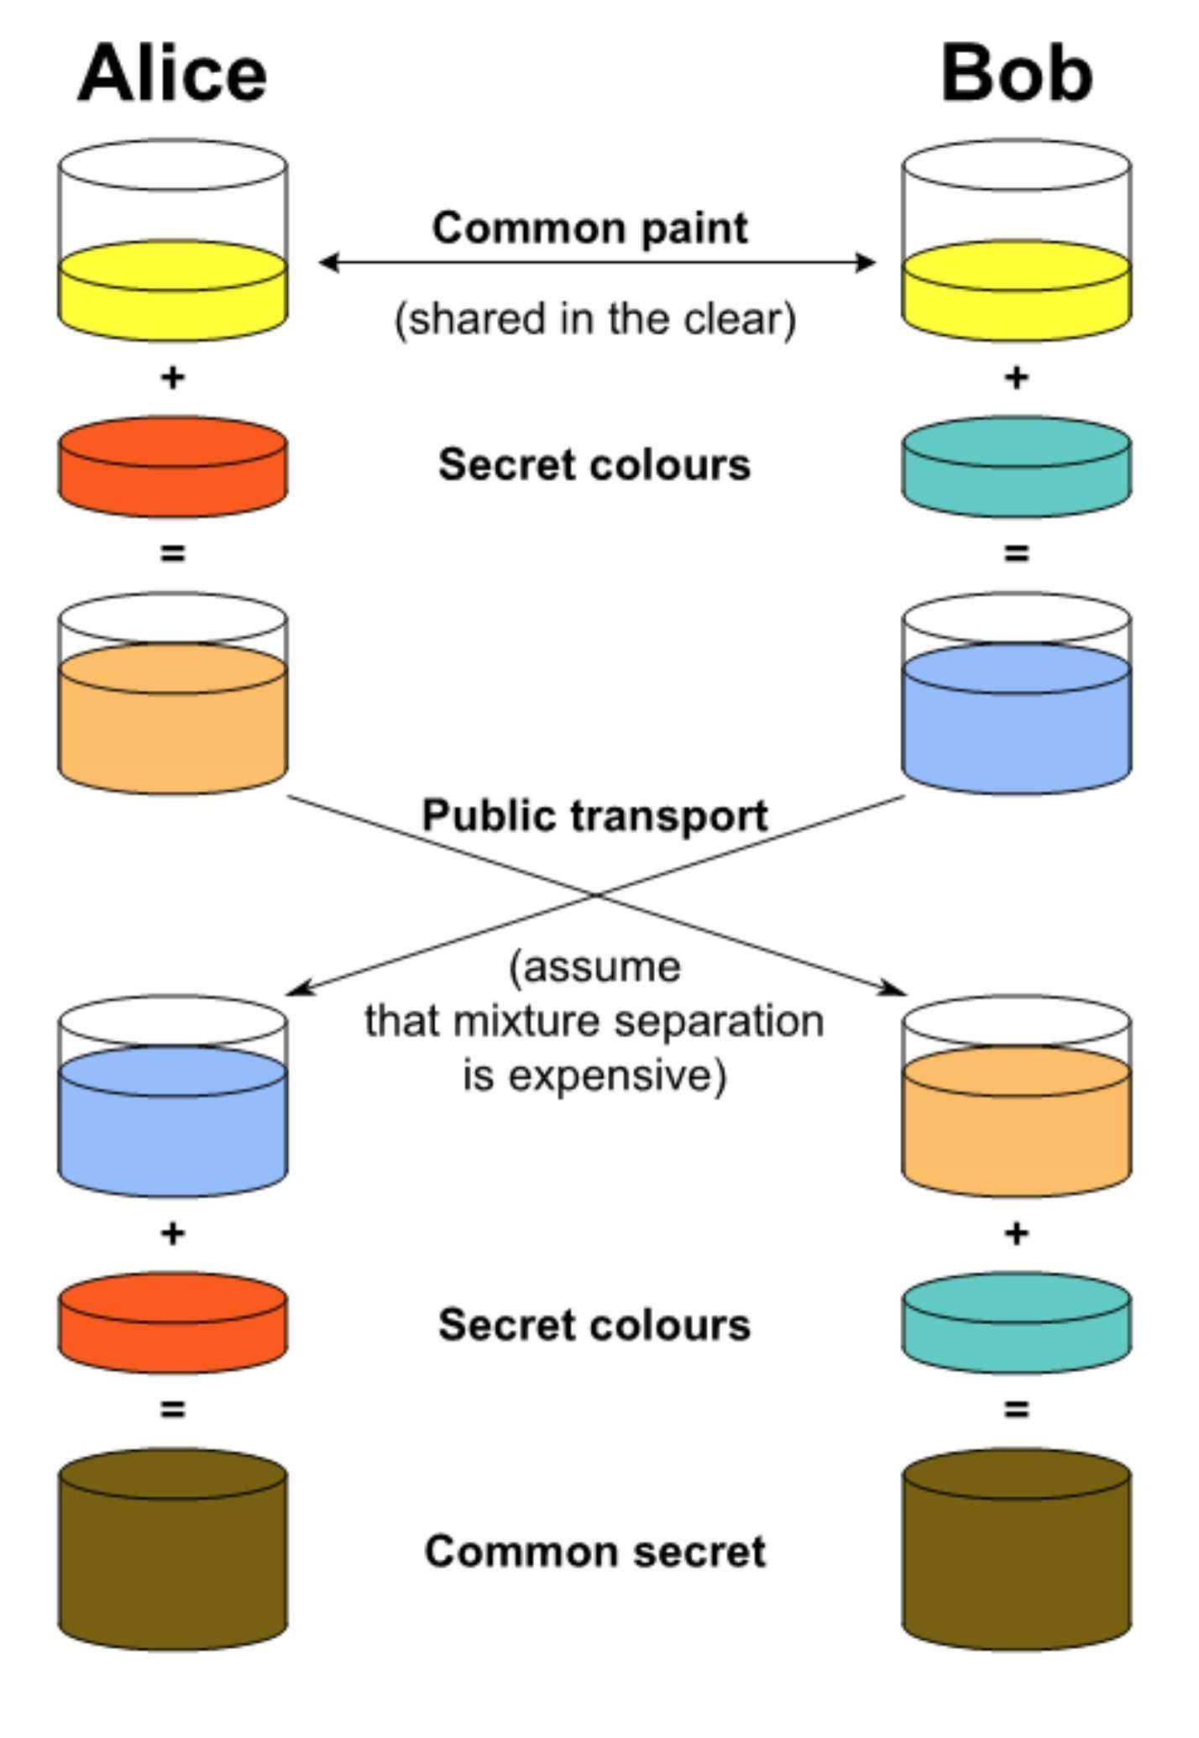
Diffie–Hellman key exchange
https://null-byte.wonderhowto.com/how-to/generate-private-encryption-keys-with-diffie-hellman-key-exchange-0180269/

Slide 13
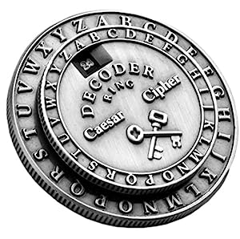
Historical Ciphers
Caesar Cipher (Rotation)
Baconian Cipher
Rail Fence Cipher
Vigere Cipher
One Time Pad

Slide 14
naq lbh, Oehghf?
Caesar Cipher (ROT13). This is how Caesar Augustus send messages to his generals.
In a Rotation Cipher the “key” is knowing how much the character-set has been rotated. Denoted as ROT#

Slide 15
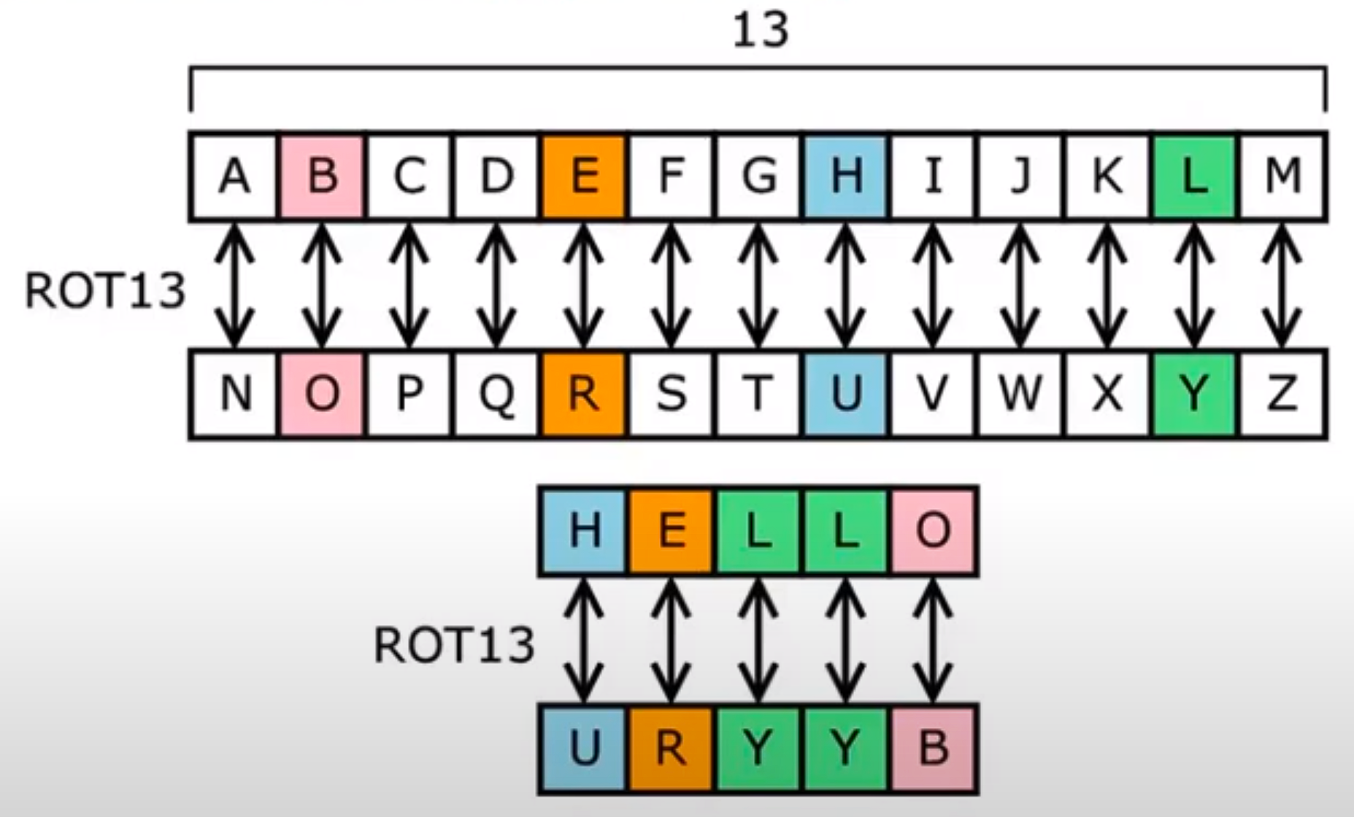
naq lbh, Oehghf?

Slide 16
AAAAB AAAAA AAABA ABBAB ABBAA ABAAA AAAAA ABBAA AAABA ABAAA ABBBA AABBB AABAA BAAAA
Attributed to Sir Francis Bacon, this is a binry substation cipher where each letter is represented as a five letter sequence of A’s and B’s based on the position of the plaintext letter in the alphabet.

Slide 17
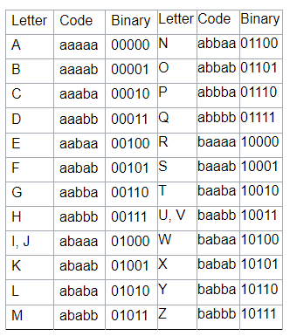
Baconian Cipher
Historically, people will use the same 5-digit binary string for I and J and for U and V, as they follow the classical Latin alphabet.
AABBB AABAA ABABA ABABA ABBAB BABAA ABBAB BAAAA ABABA AAABB
https://privacycanada.net/baconian-cipher/

Slide 18
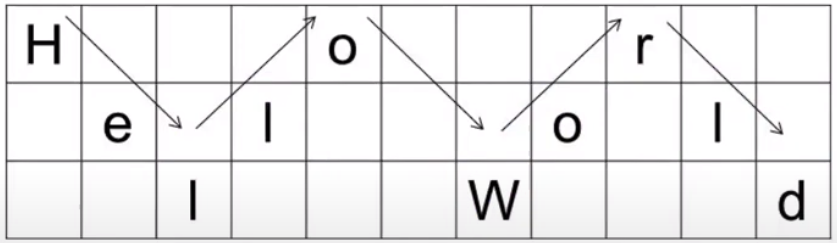
Rail Fence Cipher
A transposition cipher that rearranges plaintext by zig-zagging along “rails”
Plaintext is written diagonally from top down then down to top after the final rail is reached.
HORELOLLWD

Slide 19
Vigenere Cipher
A polyalaphabetic substitution cipher.
Each letter in plaintext is shifted by a different amount
The “key” phrase is repeated until it matches the length of the plaintext then each plaintext is shifted according to the corresponding letter in the “key”

Slide 20
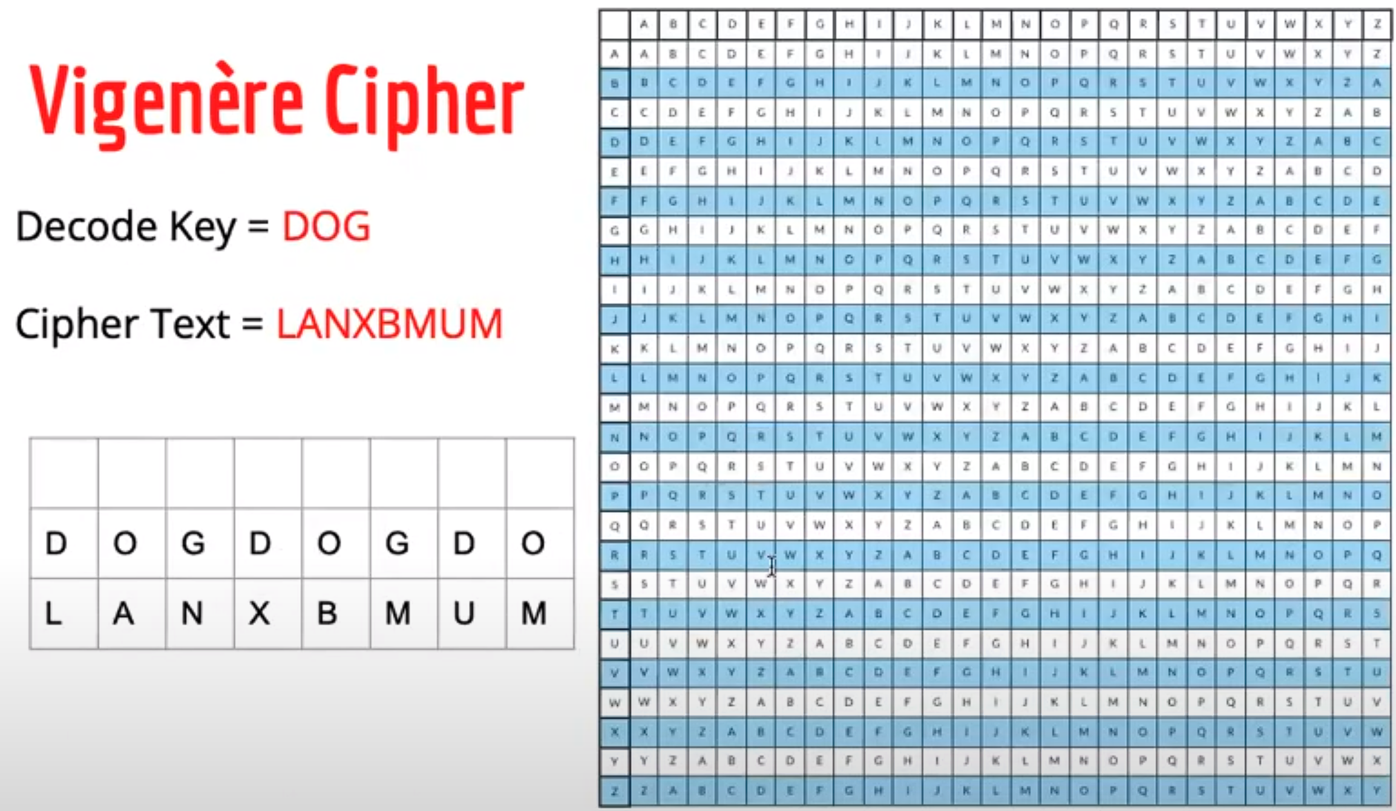
Vigenere Cipher

Slide 21
Vigenere Cipher
I

Slide 22
Vigenere Cipher
I
M

Slide 23
Vigenere Cipher
I
M
H

Slide 24
Vigenere Cipher
I
M
H
U

Slide 25
Vigenere Cipher
I
M
H
U
N

Slide 26
Vigenere Cipher
I
M
H
U
N
G

Slide 27
Vigenere Cipher
I
M
H
U
N
G
R

Slide 28
Vigenere Cipher
I
M
H
U
N
G
R
Y

Slide 29
One Time Pad
Symmetric encryption that uses a random key of the same length as the plaintext and is only used ONCE.
Each plaintext charter is combined with the corresponding key charter using modular addition (typically XOR)
Considered mathematically unbreakable if and only if the key is truly random.

Slide 30
Modern Encryption
7z encryption allows us to password protect compressed archives
7z uses Advanced Encryption Standard (AES) with a variable key length of 256bits

Slide 31
Modern Encryption
GNU Privacy Guard (GPG) encryption is widely used to encrypt data and communications using public keys.
Popular choice for securing email communications and file transfers.

Slide 32
Modern Encryption
Digital Certificates are used to verify the authenticity of an entity such as a website
Contains details such as the entity’s public key and the digital signature of a trusted third party known as a Certificate Authority (CA)
The CA is similar to vouching for a friend you know is trustworthy. The faith in trust in the CA is transferred to the other entity
Used often on the internet especially with Transport Layer Security (TLS) encryption to verify HTTPS websites.

Slide 33
Modern Encryption
Secure Socket Layer (SSL) provides encryption on the socket layer allowing us to securely transmit data over the internet.
Again used in securing HTTPS connections

Slide 34
Public Key Infrastructure (PKI)
A framework that provides for secure communication and data transfers over public networks (The Internet) using public key cryptography.
Uses digital certificates issued by a CA to bind public keys with their user’s identity.
PKI is used across many platforms such as web browsers, secure email, and virtual private networks (VPNs).

Slide 35
PKI and SSL
PKI is a framework that manages certificates and keys.
SSL is the encryption protocol used by many services such as PKI

